Slide 1
Author Study:
Jacqueline Woodson
Deidre Oates
Tim West

Slide 2
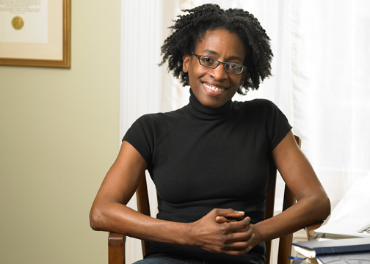
Jacqueline Woodson

Slide 3
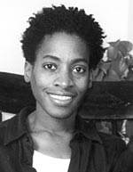
Background Information
Born February 12, 1963 in Columbus, Ohio
Grew up in Greenville, South Carolina and Brooklyn, New York.
Graduated from college with a B.A. in English
Former drama therapist for runaways and homeless children.
Open Lesbian
Daughter named Toshi and son named Jackson-Leroi
Enjoys, reading, writing, sewing, and politics.

Slide 4
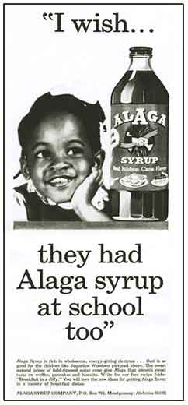
Something many people don’t know about me:
“When I was a toddler, I did a series of advertisements for Alaga Syrup in Ebony Magazine. Even though I was only two, I looked a lot older and the ads that ran often featured me as a school-aged child thinking about Alaga Syrup.
I don’t remember loving it. But it was technically, my first job.”
Notes:
From her website: http://www.jacquelinewoodson.com/alaga.shtml

Slide 5
"For as long as I can remember, I've wanted to write. I never thought there'd come a day when I could sit for hours doing just that and same days, it still feels like a sweet dream. I write because I believe there are so many stories to tell and so many people in the world who have historically not been a part of our literature. When I was a kid, I rarely came across images of African Americans on the page. I write because I absolutely love writing-and because I believe literature can change the world."
--Jacquelyn Woodson

Slide 6

"Everything from the food I grew up eating to the music I learned to dance to had the flavors of both the South and Puerto Rico“.
Meet the Author: Jacqueline Woodson

Slide 7
"I think, growing up, I felt like I was on the outside a lot; and I think, as a grownup, I've… realized that it's okay to be on the outside“.
Favorite Authors
Virginia Hamilton
Judy Blume
Chris Rascka
Chris Lynch
Chris Myers
Favorite Books
The Selfish Giant
Oscar Wilde
The Little Match Girl
Hans Christian Anderson
Stevie
Jon Steptoe
Notes:
Woodson often writes about difficult issues that young people face and characters who feel out of place.

Slide 8
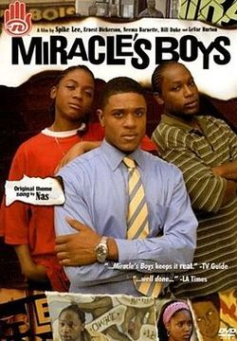
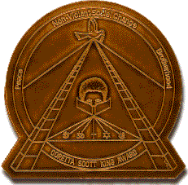
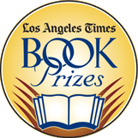
Awards and Accreditations
Coretta Scott King Honor
Los Angeles Times Book Prize
Notes:
The Coretta Scott King Book Award is presented annually by the Coretta Scott King Committee of the American Library Association's Ethnic Multicultural Information Exchange Round Table (EMIERT). The award (or awards) is given to an African American author and an African American illustrator for an outstandingly inspirational and educational contribution. The books promote understanding and appreciation of the culture of all peoples and their contribution to the realization of the American dream. The Award is further designed to commemorate the life and works of Dr. Martin Luther King Jr. and to honor Mrs. Coretta Scott King for her courage and determination to continue the work for peace and world brotherhood. (copied from the ALA website)
ALA Best Book for Young Adults
Sequoyah Book Award Master List, Young Adult Category
2003-2004 Sunshine State Master List (grades 6-8)
2003-2004 Georgia Children’s Book Award nominee
Became a mini-series

Slide 9
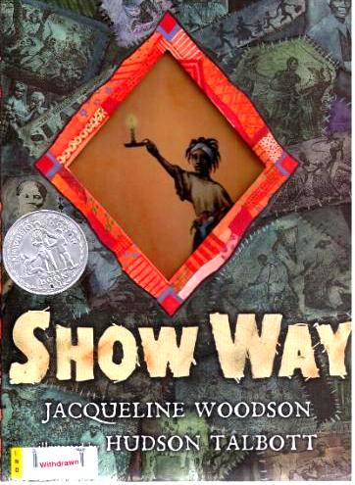
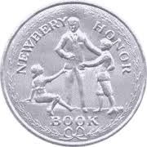
Awards and Accreditations
Newbery Honor
Notes:
The Newbery Medal was named for eighteenth-century British bookseller John Newbery. It is awarded annually by the Association for Library Service to Children, a division of the American Library Association, to the author of the most distinguished contribution to American literature for children.
Robert Kirsch, whose idea became the inspiration for the Los Angeles Times Book Prizes, was the newspaper’s book critic from 1952 until his death in 1980. In addition to writing criticism, Kirsch was a novelist, editor and teacher.

Slide 10

Jacqueline Woodson Reads from Show Way
Meet the Author Program

Slide 11
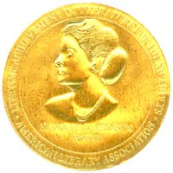
Margaret A. Edwards Award for lifetime achievement in writing for young adults.
I Hadn’t Meant to Tell You This
Lena
From the Notebooks of Melanin Sun
If You Come Softly
Miracle’s Boys
Notes:
2006 Margaret A. Edwards Award honoring her outstanding lifetime contribution to writing for teens.
The Margaret A. Edwards Award, established in 1988, honors an author, as well as a specific body of his or her work, that have been popular over a period of time. The annual award is administered by YALSA and sponsored by School Library Journal magazine. It recognizes an author's work in helping adolescents become aware of themselves and addressing questions about their role and importance in relationships, society, and in the world. (copied from the The American Library Association website)

Slide 12
Jacqueline Woodson
Trends and common themes
African-American history and culture.
Family (picnic)
Struggles (coping with death of a family member, foster care, war, slavery, breaking racial barriers)

Slide 13
Jacqueline Woodson
Triumphs
Children sold into slavery are able to keep their history and culture and escape to freedom.
Children placed into foster care have a successful ending due to a caring aunt.
Women are allowed to enter the work force.
Racial barriers are broken.

Slide 14
Jacqueline Woodson
Connection to Curriculum:
African-American History and Culture
Women’s Rights Movement
Slavery
Civil Rights Movement

Slide 15
References
"About Jacqueline Woodson - On the Same Page Cincinnati - Cincinnati.Com." About Jacqueline Woodson - On the Same Page Cincinnati - Cincinnati.Com. Web. 05 June 2012. <http://www.cincinnati.com/samepage04/author_woodson.html>.
Adlit. "Meet the Author: Jacqueline Woodson." YouTube. YouTube, 01 Feb. 2011. Web. 05 June 2012. <http://www.youtube.com/watch?v=KfGBtIG6CgM>.
"Crime Watch." : The Best of 2009: Los Angeles Times Book Prizes (Mystery/Thriller). Web. 05 June 2012. <http://kiwicrime.blogspot.com/2010/02/best-of-2009-los-angeles-times-book.html>.
"Google Images." Google Images. Web. 05 June 2012. <http://www.google.com/imgres?imgurl=http://upload.wikimedia.org/wikipedia/en/thumb/f/ff /Miracle'sBoysDVD.jpg/250px-Miracle'sBoysDVD.jpg>.
"Jacqueline Woodson: Something Many People Don't Know about Me." Jacqueline Woodson: Something Many People Don't Know about Me. Web. 05 June 2012. <http://www.jacquelinewoodson.com/alaga.shtml>.
"Kawzmik World." Kawzmik World. Web. 05 June 2012. <http://kawzmikworld.wordpress.com/2012/05/07/show-way-by-jacqueline-woodson/>.
"Penguin.com (usa)." The Books of Jacqueline Woodson. Web. 05 June 2012. <http://us.penguingroup.com/static/rguides/us/jacqueline_woodson.html>.
"Really Great Books!" Really Great Books! Web. 05 June 2012. <http://libraries.risd.org/frelib/rgbooks.htm>.
"Seals of Approval- A Guide to Young Adult Book Awards â WhatchYAreading?" Seals of Approval- A Guide to Young Adult Book Awards â WhatchYAreading? Web. 05 June 2012. <http://whatchyareading.net/2012/02/13/seals-of-approval-a-guide-to-young-adult-book- awards/>.

